Slide 1
Hinges Logic for All customers and all Frame types Single Double
Create a DXF For the cut-out
A
B
C
One Customer could have more than 3 sizes
Save each shape in Library and add reference Point. This reference point is used for placing these cutouts

Slide 2
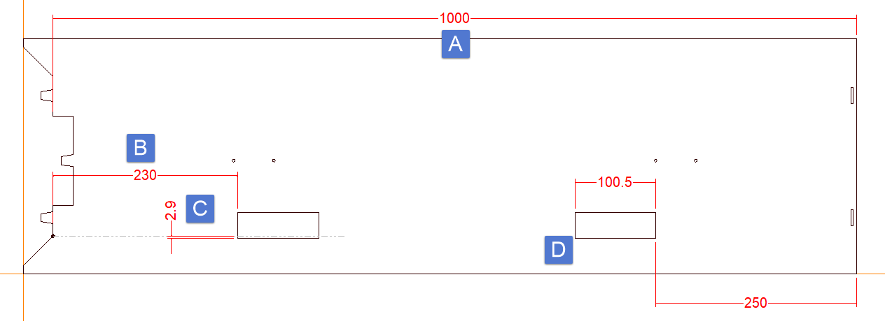
When Placing
Auto select the Shape based on Logic Eg: Rebate 41-46 Shape B, 46-51 Shape A ( Logic will be provided)
How Many Hinges -2,3,4,5 etc
Setup Several Logics
If 2 Hinges
Establish the reference point TOP HINGE
Position B Variable depends on each customer we should be able to input this to any number
Position C again(-) Variable from customer to customer also it could change based on Hinge selected, this actually thickness of hinge.
Position D Reveal Height-Bottom Hinge Position+Hingewidth

Slide 3
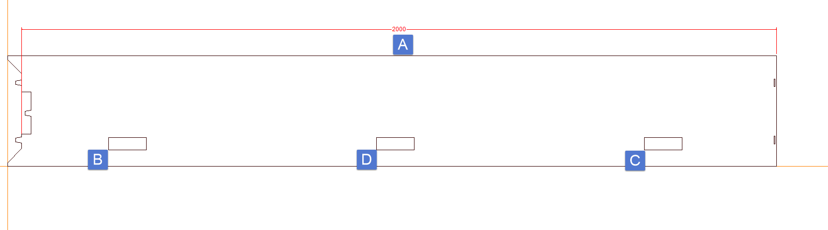
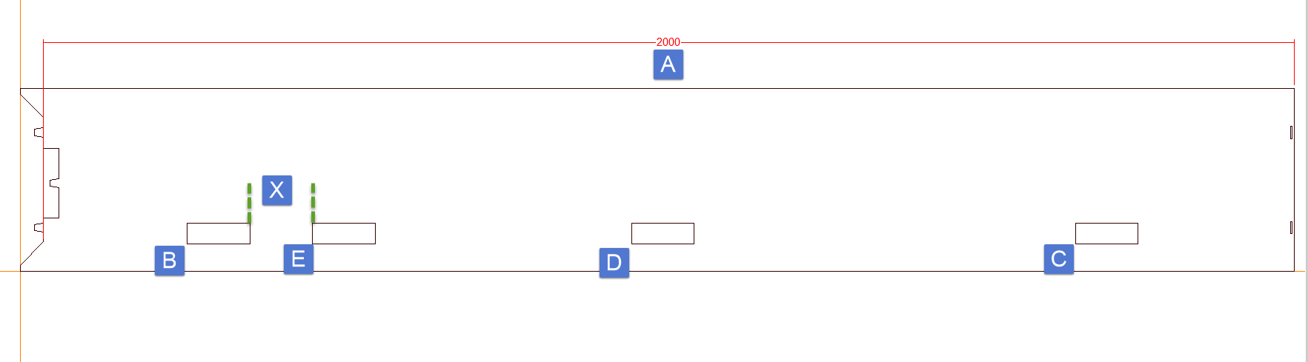
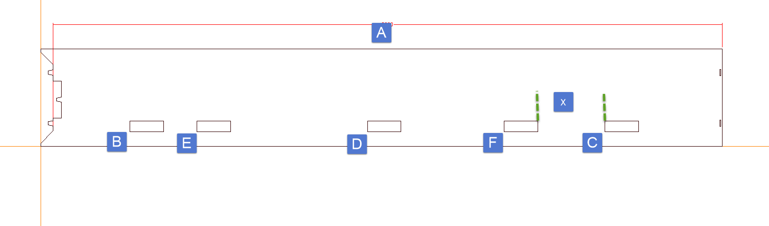
3 hinges
Position D=
C-B= x/2
Position E=
B+ Selected Hinge length+
Customers choice of GAP X
F=
C-x( from Customer)-Hinge length

Slide 4
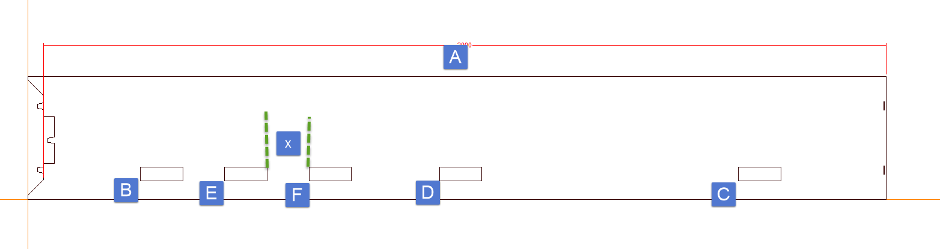
Some times F position cane be different.
So
F=E + X( from Cust)+Hinge length

